Slide 1
Universities in Innovation
November 3, 2022

Slide 2
Triple Helix
University research functioning increasingly as a locus in the “laboratory” of knowledge-intensive network transitions
Increasing salience of knowledge and research to economic development opening up a “third mission”
“Second academic revolution”?

Slide 3
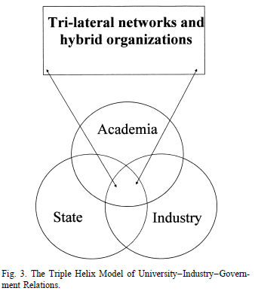
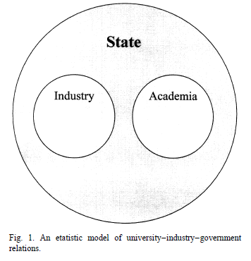
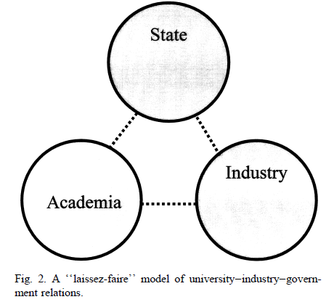
Triple Helix
Varying institutional arrangements of university-government-industry relations

Slide 4
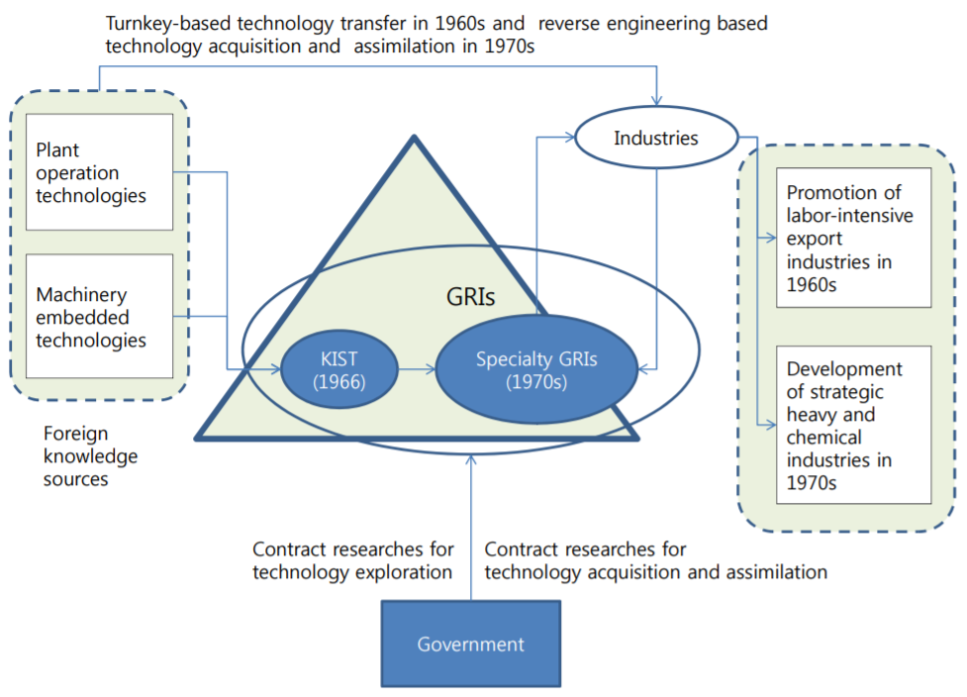
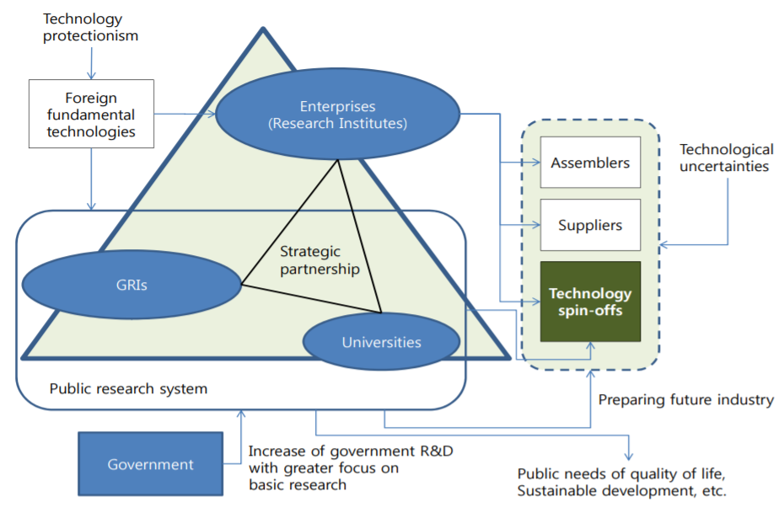
Korean Context
Universities emerging in the 1990s as a core partner of Korean triple helix
Shin, T., et al. 2012. Korea’s Strategy for Development of STI Capacity: A Historical Perspective. STEPI.
1970s vs. 1990s

Slide 5
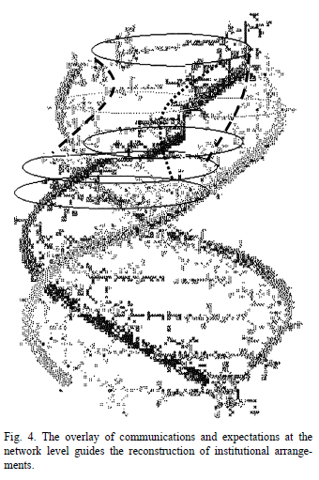
Triple Helix
NIS as a starting point when describing a system of innovation
New mode of knowledge production → system of innovation as an “emergent” system resting on a hyper-network of disciplines, industries, and governments

Slide 6
Triple Helix
Unique comparative advantage of universities?
A university combines continuity with change, organizational and research memory with new persons and new ideas, through the passage of student generations

Slide 7
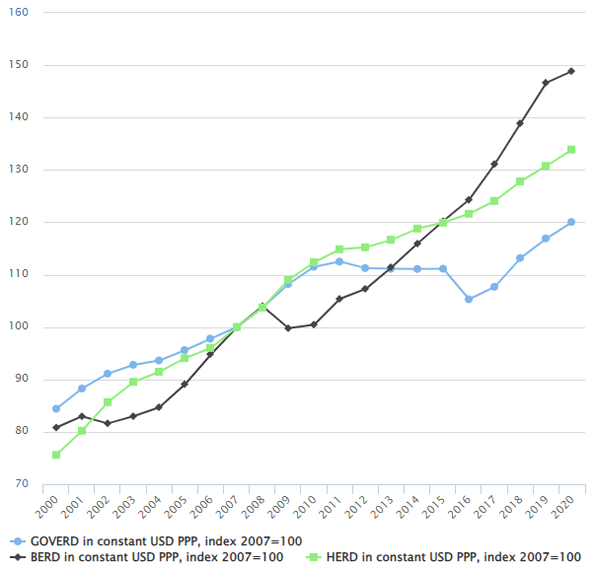
Growth of R&D Performed by Higher Education
R&D performed by higher education institutions (HEI) increasing most
2000 (Gov > Business > Higher Ed) → 2020 (Business > Higher Ed > Gov)
Meaning the rise of expectations of research/innovation coming out of HEI
Year 2020 marking the first time in which R&D expenditure didn’t drop despite global recession

Slide 8
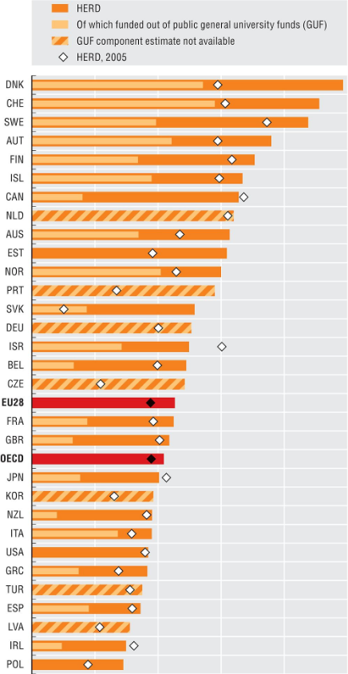
Korean Context
South Korea being the largest spender of R&D (in terms of % of GDP), yet HERD remaining below OECD average

Slide 9
Third Mission (TM)
Knowledge/ tech transfer
Triple helix (quadruple, quintuple helix…)
Community outreach
Lifelong learning
Entrepre-neurial university
Broadly defined as “contribution society”, yet nebulous in actual policies/practices
Still evolving
Difficult to measure due to heterogeneity of institutional profiles and strategies of universities
Often remaining to be mere statements or principles

Slide 10
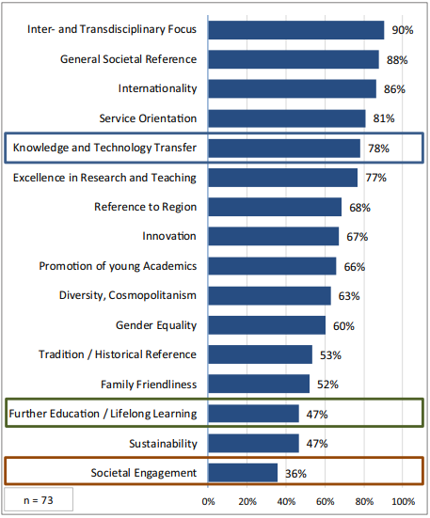
Third Mission
Societal engagement (e.g., citizen science, public participation, social entrepreneurship) mentioned much fewer times than knowledge/technology transfer in the mission statements of 73 German universities (Berghaeuser & Hoelscher 2019)

Slide 11
Korean Context
Third Mission mostly equated to the entrepreneurial university (with focus on tech transfer/commercialization)
Notable exception: “Research & Solution Development (R&SD) Program”
Launched in 2013 to promote socially driven R&D by developing tech solutions for social problems
Yet remaining as small scale piloting and sometimes with a strong bent on “technological fix”

Slide 12
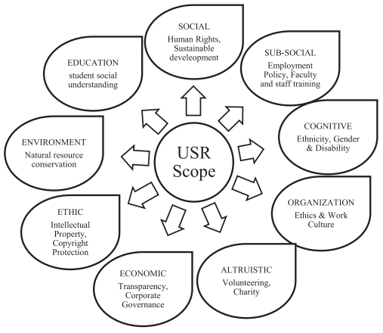

TH & University Social Responsibility
USR covering a large terrain of notions/activities/initiatives
SR in curriculum
Inculcation of SR behavior
SR in university projects
Collaboration with NGOs for SR
Stakeholder audit for USR
Indicator/tool development for USR
Integration of social development, CSR with USR
Sustainable/adaptable SR
e.g. USR Network, GUNI
(Source: Ali, et al. 2021)

Slide 13
TH & Responsible Research & Innovation (RRI)
RRI beyond Ethical/Legal/Social Implications (ELSI)
More than ‘box ticking’ exercise
Latest initiatives
European Universities Initiatives (ERA Policy Agenda 2022-24)
HEIRRI Project (2015~18), NewHoRRIzon Project (2017~21), GRACE Project (2019~21)
And more at RRI-Tools
Yet, relatively minor attention among Asian universities (though some represented in GUNI
RRI in HEI
Diversity & Inclusion
Anticipation & Reflection
Responsiveness & Adaptive Change
Openness & Transparency

Slide 14
University as a Locus of “Inter-scale” Innovation
Need to reimagine TH not as an additional/extra mission to education and research but fundamentally integral to them
Reinventing TH for local-global-planetary impacts (UN SDGs, Anthropocene challenges) with questions:
How to integrate knowledge generated with public funding for university research to link and tackle problems/issues/risks of local/national/global/planetary scales?
How to align visions of multiple stakeholders of universities to meet simultaneous challenges of these different scales?

Slide 15
University as a Locus of “Inter-scale” Innovation
Need to rethink the roles of the government for greater public-good benefits of HEI-driven innovations
Not just a detached funder for prosperity but an informed delegate of citizens for wellbeing, safety, peace, and many more common goals
Re-orienting public research funding mechanisms (with re-prioritizing policies in light of inter-scale challenges)

Slide 16
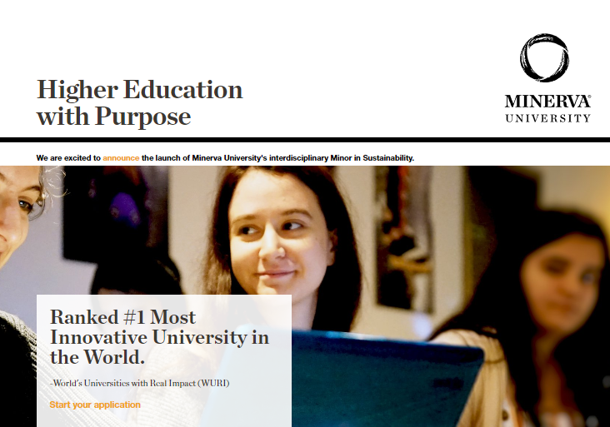
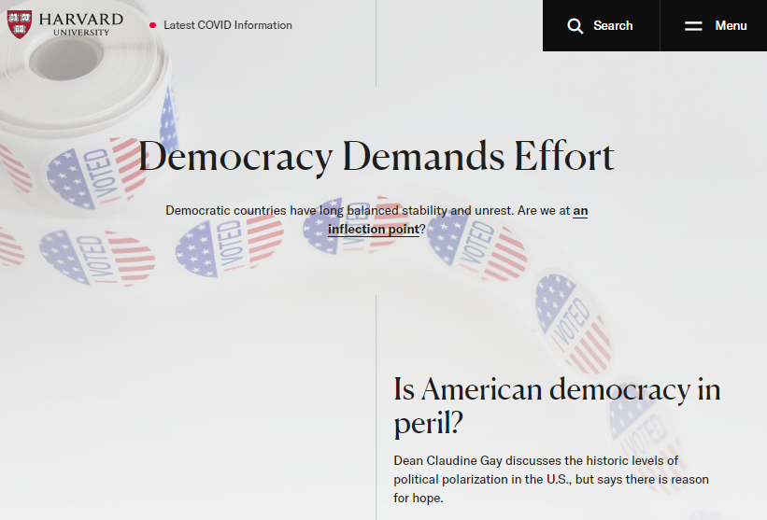
Virtual/Digital University in a Virtual/Digital Age?
vs

Slide 17
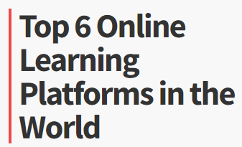
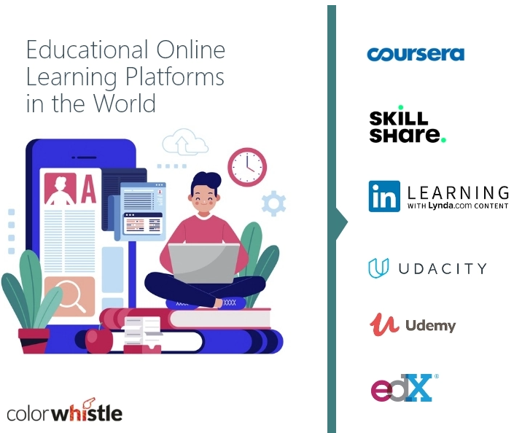
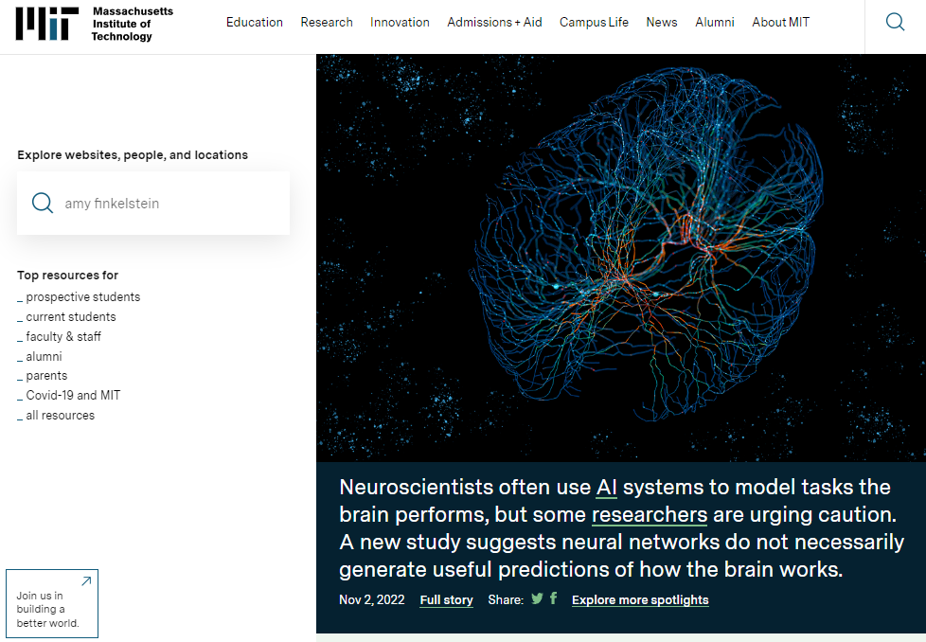
Virtual/Digital University in a Virtual/Digital Age?
vs
https://colorwhistle.com/top-online-learning-platforms/

Slide 18
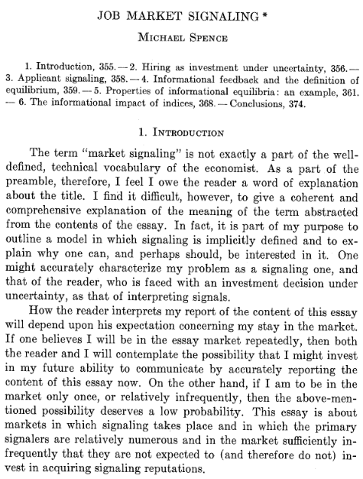
Education as a Signal
Michael Spence (1973). "Job Market Signaling," Quarterly Journal of Economics 87/3: 355–374
“Sheepskin effect”

Slide 19
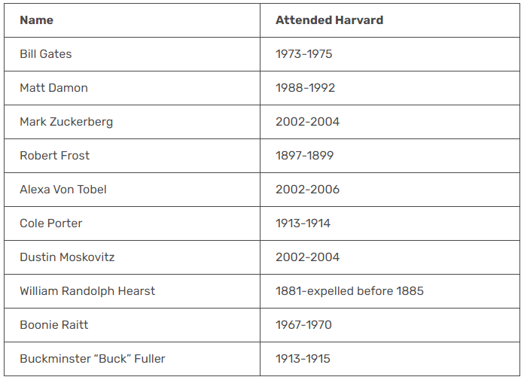
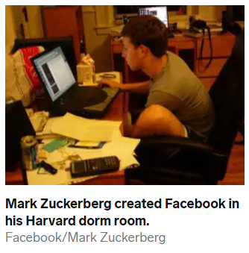
Sort of Sheepskin Effect…
https://educationweb.com.gh/education/harvard-dropouts/
Notes:
https://www.businessinsider.com/most-successful-harvard-dropouts-2014-10#composer-cole-porter-dropped-out-of-harvard-law-school-to-pursue-his-passion-for-music-6

Slide 20
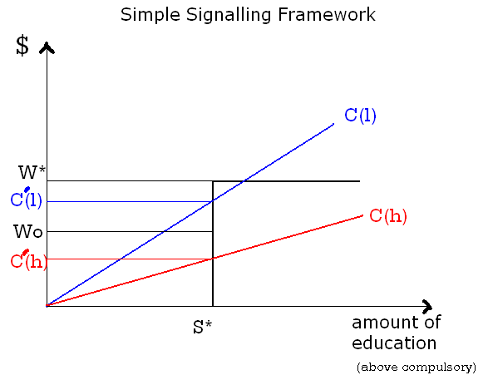
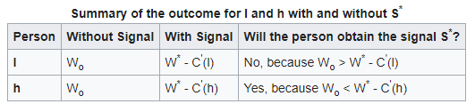
Education as a Signal
https://en.wikipedia.org/wiki/Signalling_(economics)

